Slide 1
Scrum-Agile Approach
Brandon Floyd
October 23, 2022
CS-250 7-1 fINAL

Slide 2
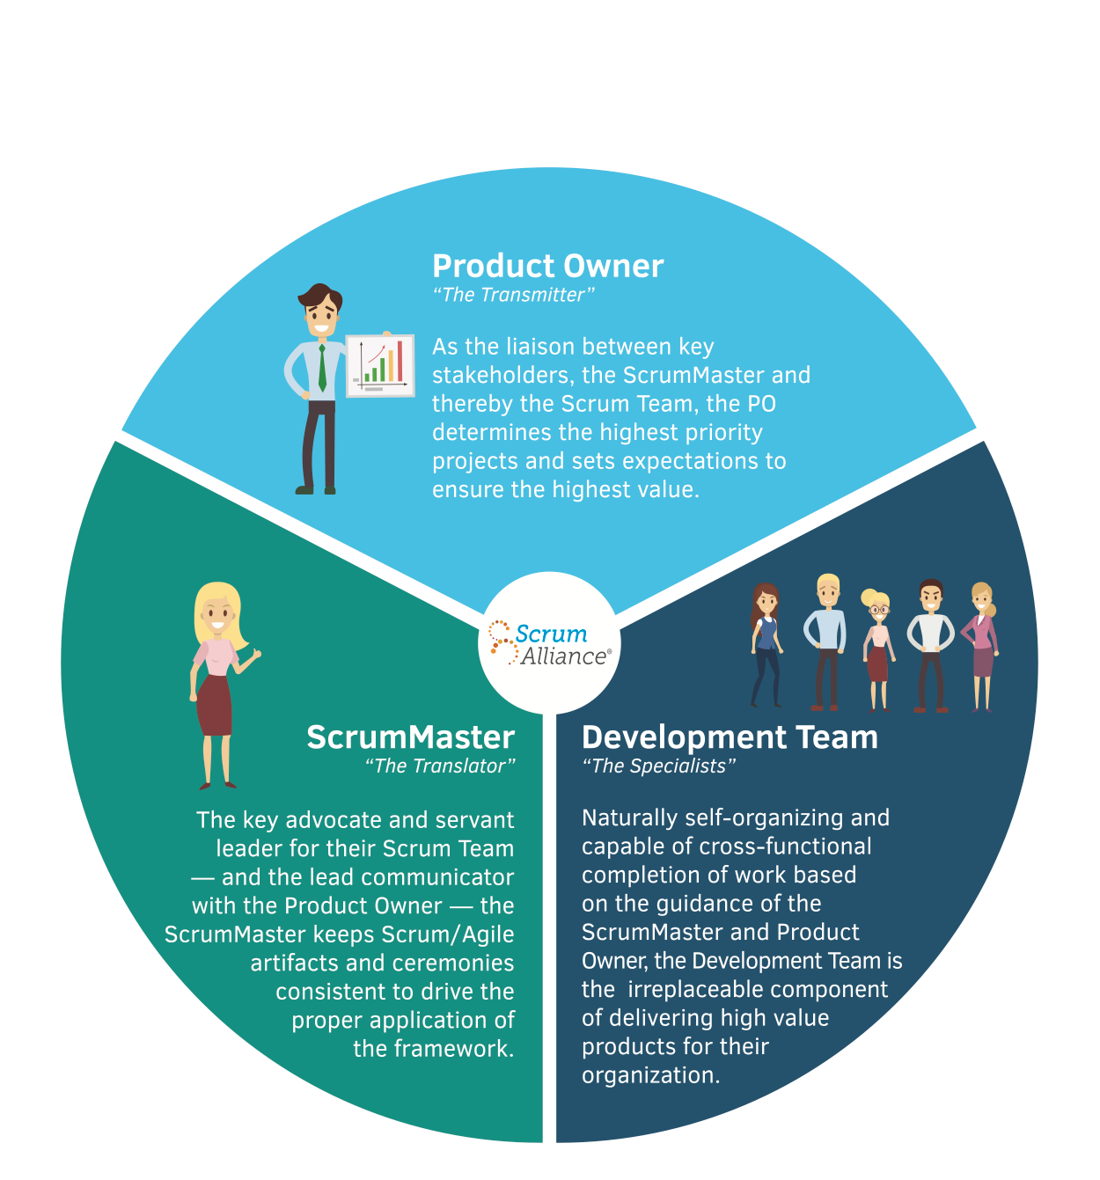
Team Roles
Scrum Master: Holds daily scrum meetings and organizes the team as well as providing them with the information obtained by the product owner.
Product Owner: Manages product backlog. Shares items and prioritizes items.
Development Team: Self-organizing group responsible for the creation of the final product.

Slide 3
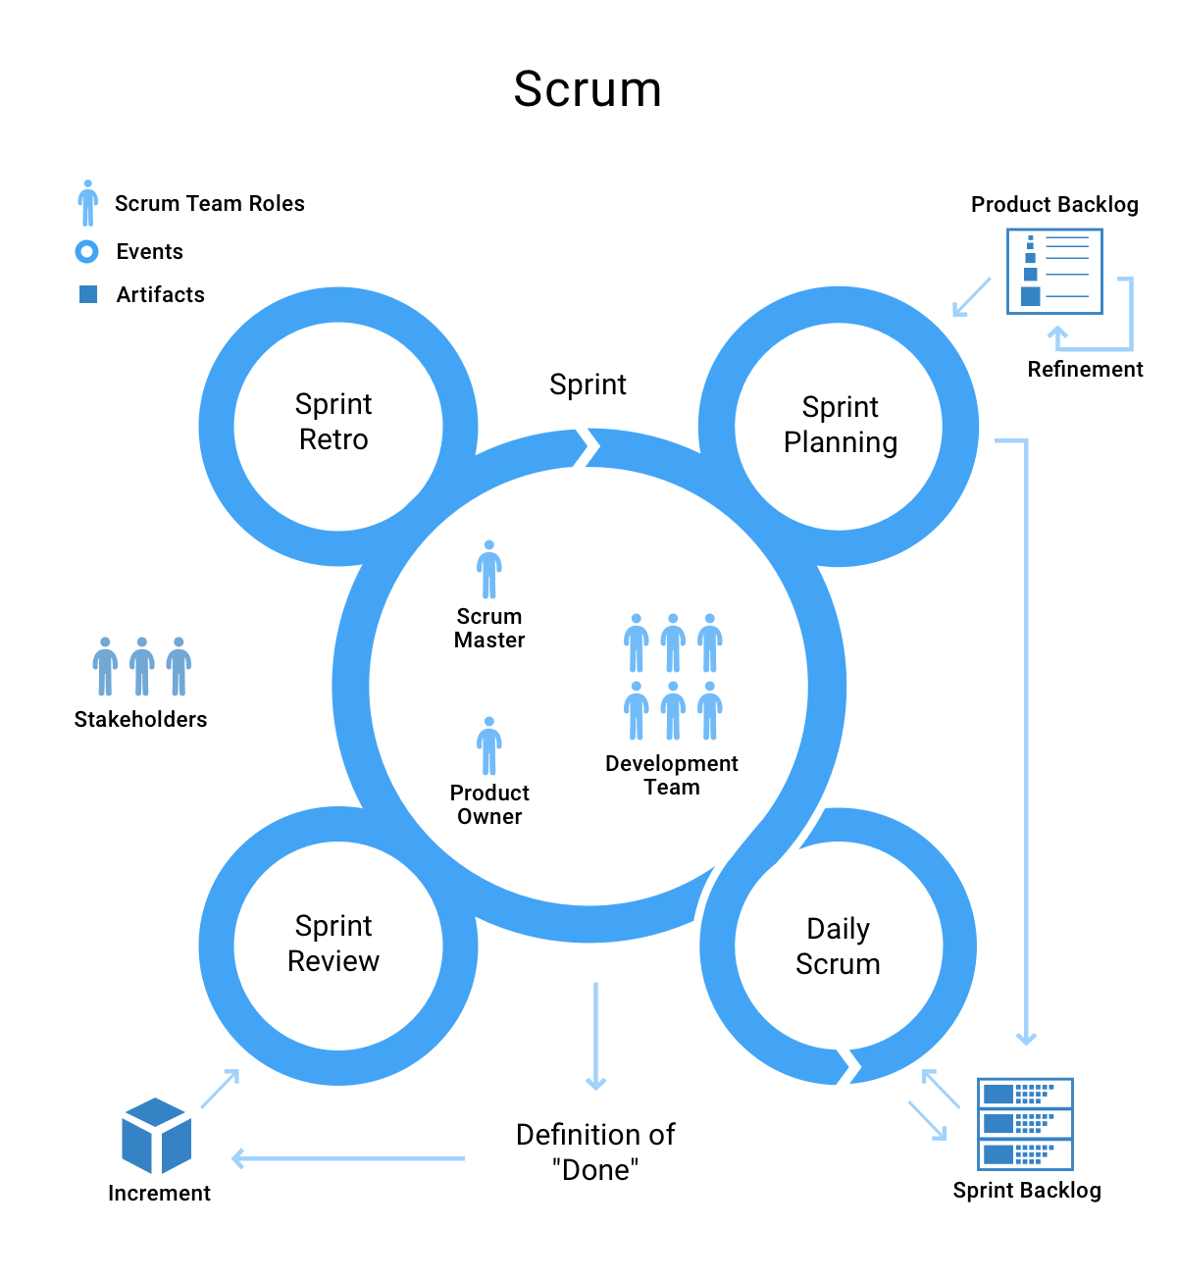
SDLC Phases
Product Owner given project idea. Breaks down ideas into user stories creating the product backlog.
Sprint planning meeting held to determine scale of the project with team.
Team works on items in product backlog for sprint duration.
Daily scrum meeting to discuss current progress and problems.
Scrum master runs meetings and provides information to product owner
Sprint end: work is submitted and then a sprint review takes place to discuss the sprint and any problems encountered during the sprint.
Sprint cycle continues until product backlog is finished.

Slide 4
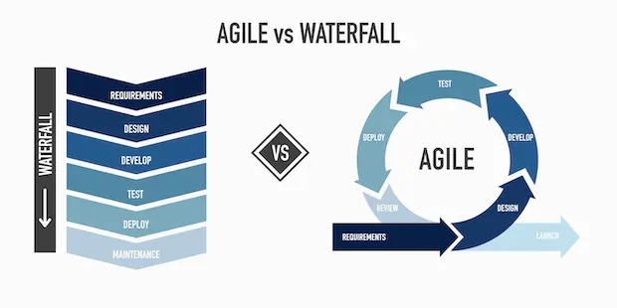
Agile vs. Waterfall
Waterfall
Agile
Fully designed at the beginning – less adaptive to change
Linear development
Define and document entire project prior to development
Plan-driven approach
Adapts to changes during development
Small Teams
Developed in smaller tasks
Adaptive approach

Slide 5
References
Cobb, C.G. (2015). The project managers guide to mastering agile: Principles and practices for an adaptive approach. Hoboken, NJ: Wiley.

